Slide 1

Visualisation with ggplot2
Kamran Khan
August 2020
Notes:
Generating visual display of your data ia a key step in the analytical process.Data visualization if done well, allows you to reveal patterns in your data and communicate insights to your audience.

Slide 2

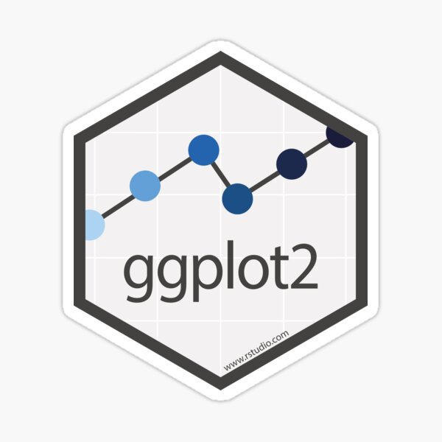



http://ggplot2.tidyverse.org/

Slide 3
What does ggplot2 stand for?
A Grammar of Graphics!
ggplot(data = <DATA>) +
<GEOM_FUNCTION>(
mapping = aes(<MAPPINGS>),
stat = <STAT>,
position = <POSITION>) +
<COORDINATE_FUNCTION> +
<FACET_FUNCTION>
You can uniquely describe any plot as a combination of these 7 parameters.
Ggplot2 cheatsheet available at https://rstudio.com/wp-content/uploads/2015/03/ggplot2-cheatsheet.pdf
Notes:
This is the template for making graphs with ggplot2. plots are created by chaining together functions using the plus (+) sign. Each function modifies the plot upto that point. Here we can replace the bracketed sections with dataset, a geom function , mappings, position, coordinate functions and facet functions to create a full graph.

Slide 4

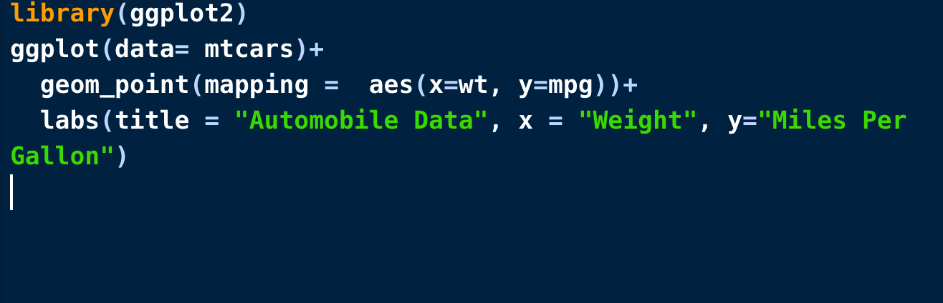
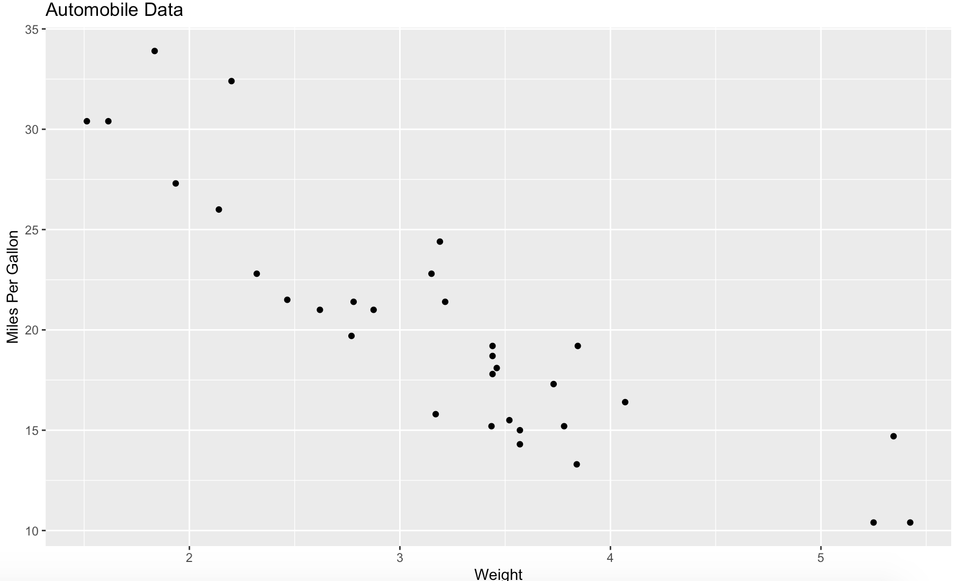
Example
Notes:
The ggplot() function initializes the plot by creating a coordinate system to which we can add layers. We specifies the data source (mtcars) an variables (wt, mpg) to be used. The options in the aes() function specify what role each variable will play. The labs function is optional and adds annotations(x-axis and title). If you want a quick simple graph there is a shortcut in ggplot2 called qplot which creates a quick simple plot.

Slide 5
ggplot graphic system
R has several systems for making graphs, but ggplot2 is one of the most elegant and most versatile.
ggplot2 implements the grammar of graphics, a coherent system for describing and building graphs.
More about the theoretical underpinnings of ggplot2 ,Please read “A Layered Grammar of Graphics”.
Notes:
We have base R graphics system, and then we have grid graphics system which is implemented through grid package, then we have lattice package and finally ggplot2.

Slide 6
Why use ggplot2?
Automatic legends, colours, etc.
The default output is much nicer than base graphics.
Easy superposition, faceting, etc.
Store any ggplot2 object for modification or future recall.
Lots of users (less bugs, much help on Stack Overflow).
Lots of extensions.
Nice saving option.

Slide 7
Aesthetic mapping
Aesthetic is a visual property of the objects in your plot.
It include things like the size, shape and colour of your points.
We can map the aesthetics in our plot to a variable in the dataset.
For example to map the colour of our points to the class variable.

Slide 8
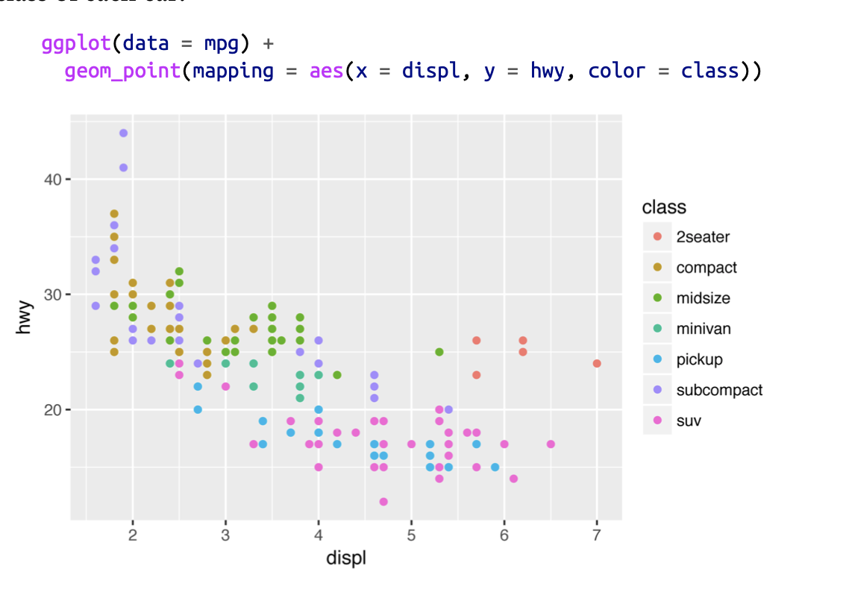
example
Notes:
Ggplot2 will assign a unique level of the aesthetic (here a unique colour to each unique value of the variable class. This process is called scaling. It will also add a legend explaining which level correspond to which value.
Here the displ is the variable from the data mpg which represents the engine size and hwy is the car’s fuel efficiency on the highway in miles per gallon. A car with low fuel efficiency consumes more fuel and it depends on the engine size.

Slide 9
Specifying geometrics
The obvious distinction between plots is the geometric objects that they include
ggplot2 use a number geom_functions
geom_point() for drawing individual points(e.g. scatterplot)
geom_line for line chart
geom_smooth() for drawing smooth lines(e.g. simple trends)
geom_col() for drawing columns (e.g. bar chart)
geom_polygon() for drawing arbitrary shapes(e.g. area in a coordinate plane)
Notes:
Geoms is the geometrical object that a plot uses to represent data.

Slide 10
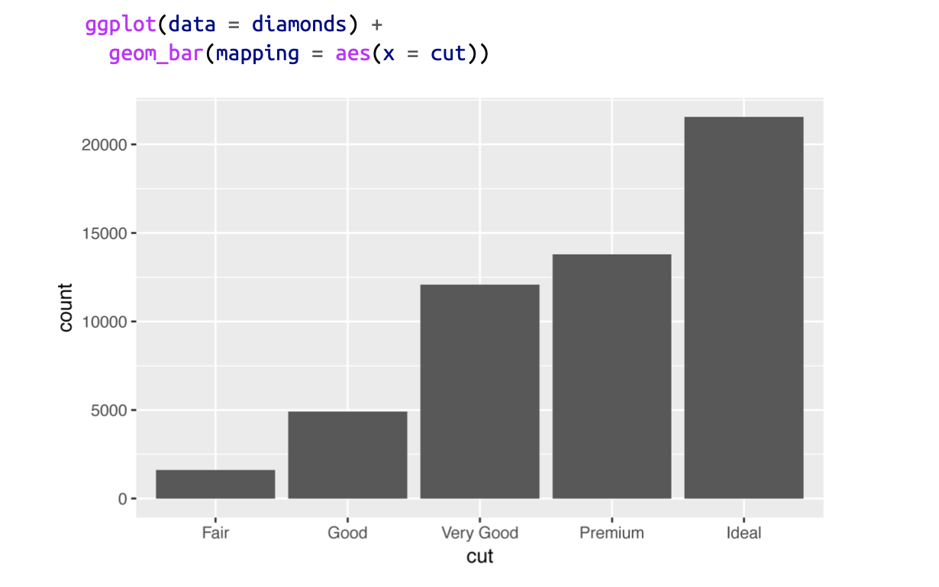
Bar charts: diamonds dataset in ggplot2
Notes:
The chart shows that more diamond are available with high-quality cut than with low quality cut. The x-axis displays cut, a ‘variable from diamond’. On the y-axis it displays the count, but count is not a variable in the diamonds dataset. The diamond dataset is about ~54,000 diamonds and information about their size, price, carat, clarity and cut. The stat function in geom_bar is count by default.

Slide 11
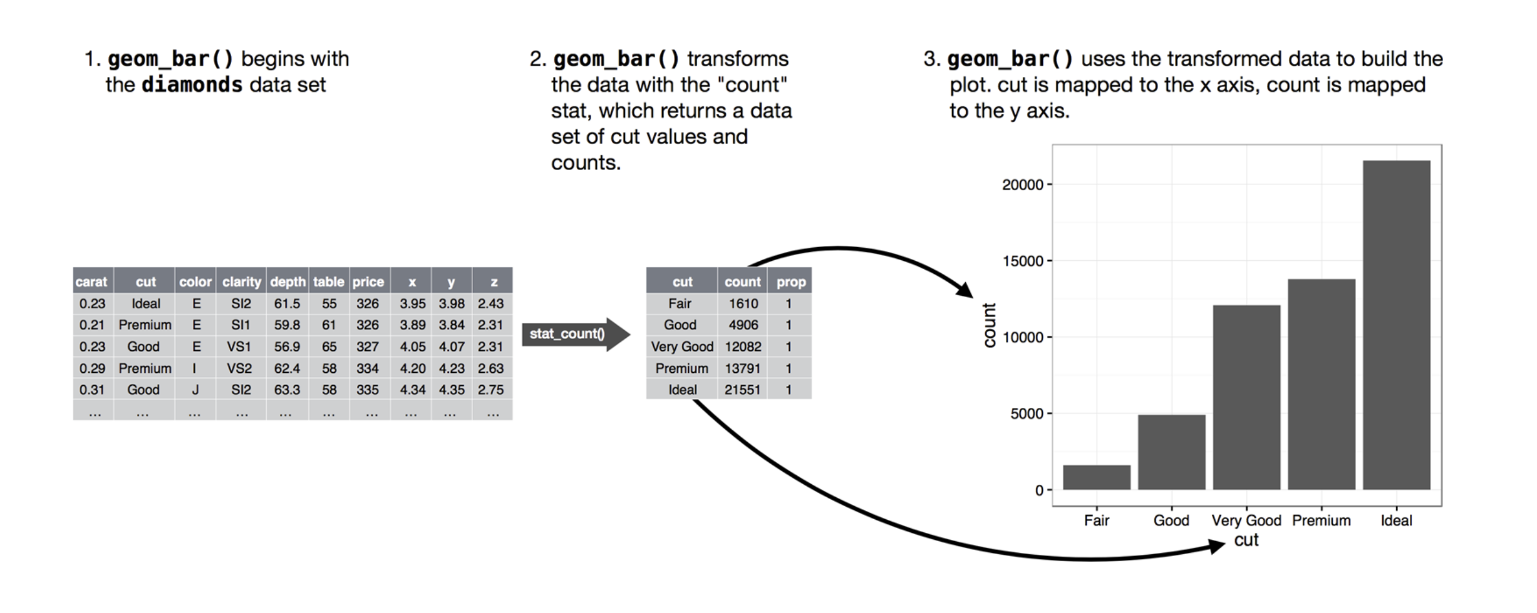
Statistical transformation (stat)
Notes:
The algorithm used to calculate new values for a graph is called a stat, short for statistical transformation. This figure describes how this process works with geom_bar(). Here the default value for stat is count which
Counts the number of diamonds in each cut category.

Slide 12
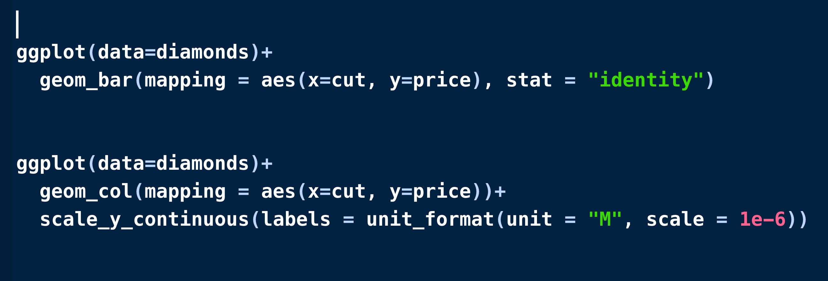
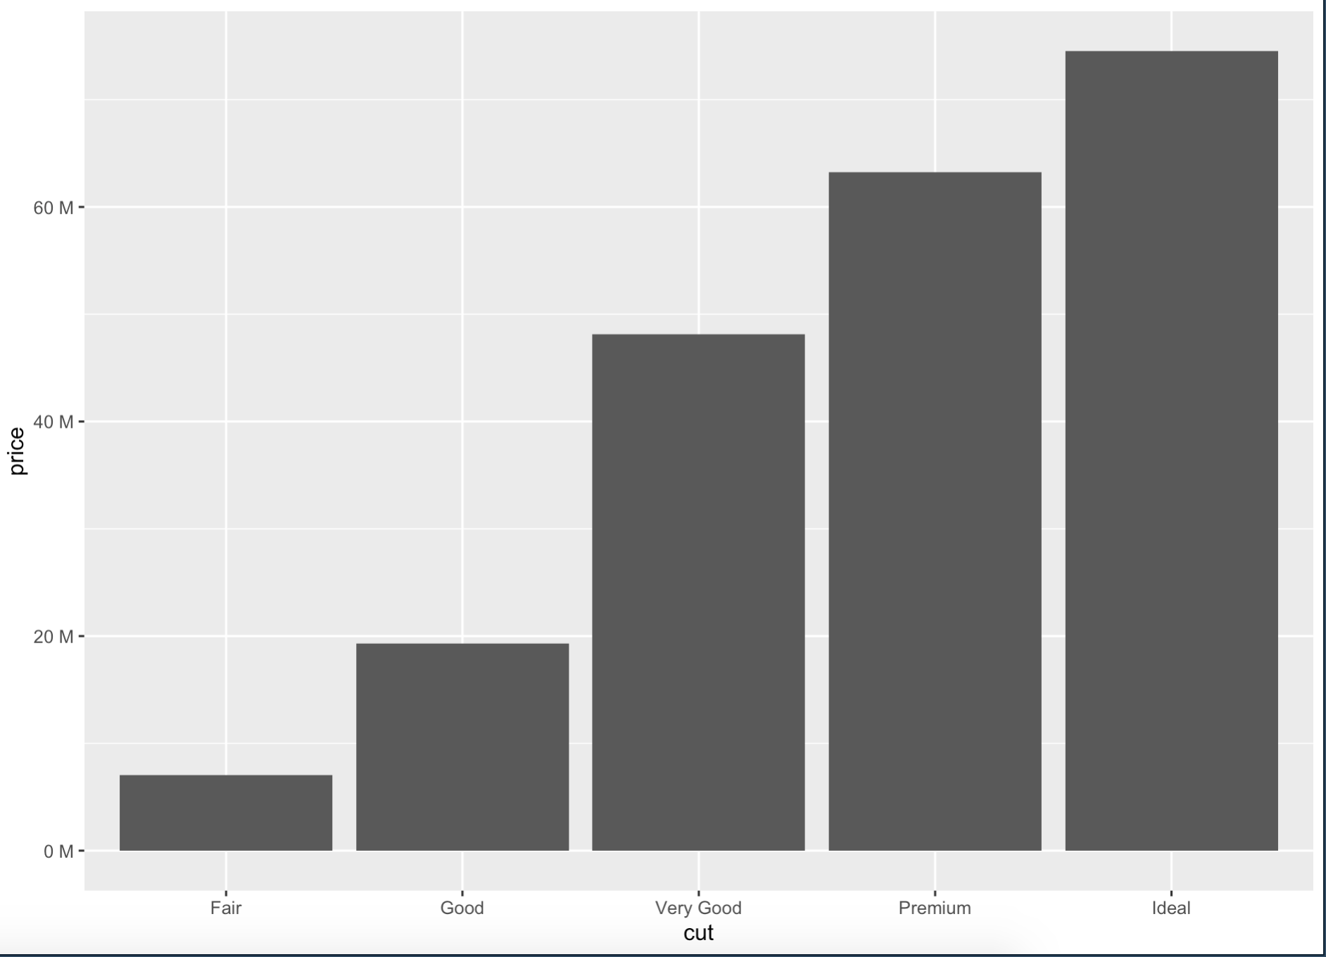
Using stat explicitly
We might want to override the default stat = “count” for example when we want another variable from the dataset as our y-axis.
Or we can use geom_col instead of geom_bar and we don’t have to specify the stat=“identity then.
Notes:
geom_col() uses stat_identity()

Slide 13
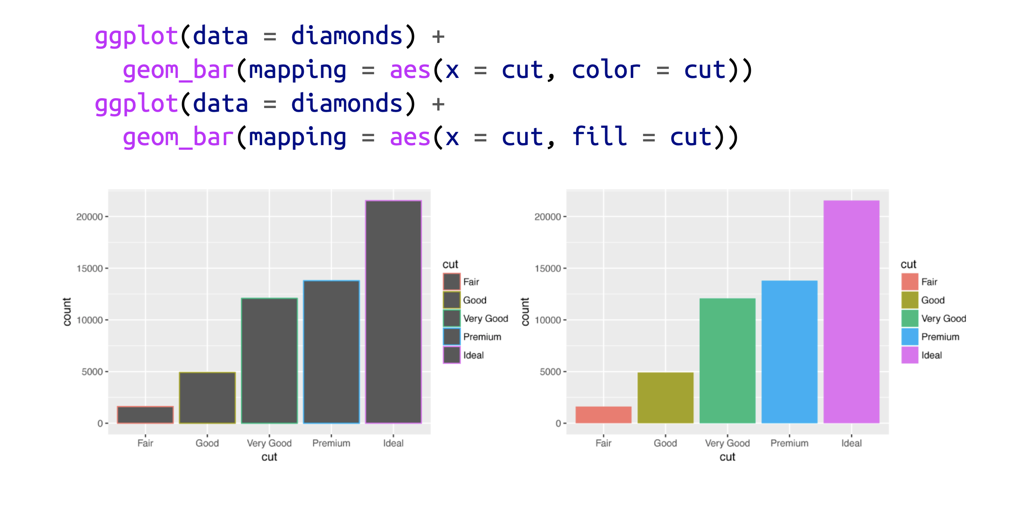
Positional adjustments
Notes:
We can colour the bar chart using the color aesthetics or more usefully the fill.

Slide 14
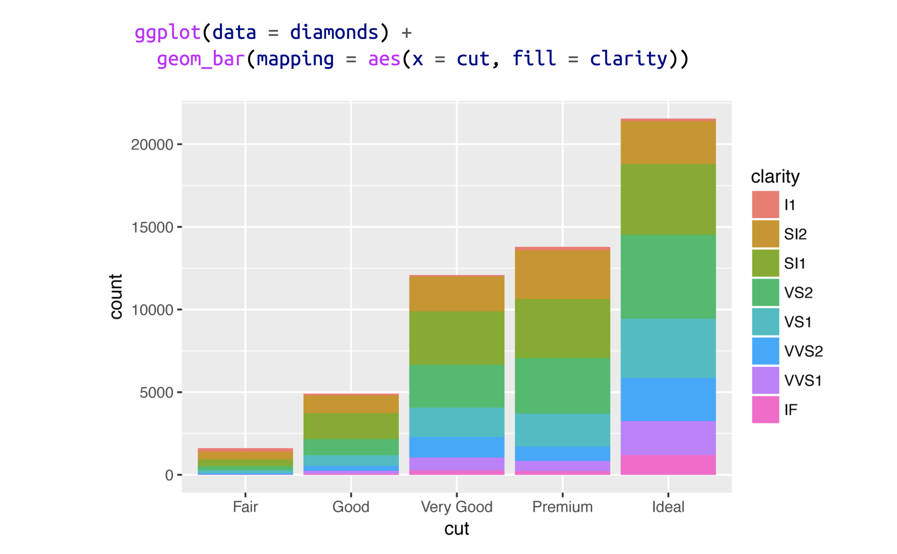
Using another variable as fill
Notes:
We can use another variable in this case the clarity as a fill. Here the bars are automatically stacked and each coloured rectangle represents a combination of cut and clarity. The stacking is performed automatically by the position adjustment specified by the position argument.

Slide 15
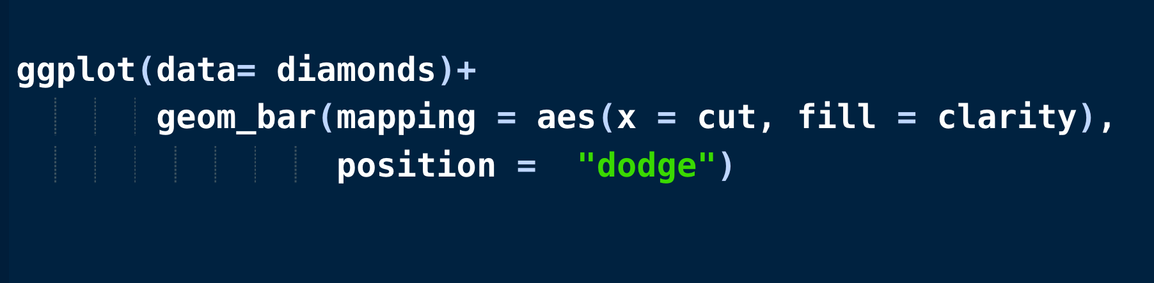
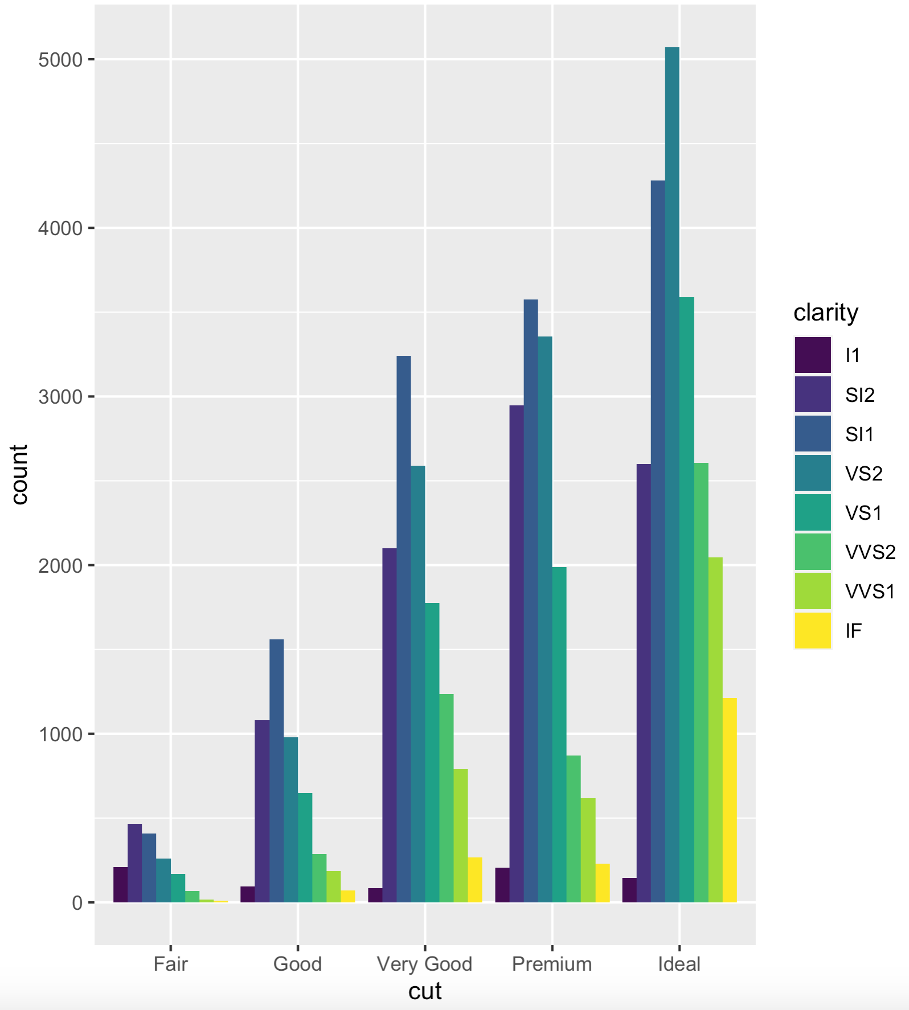
Position = “dodge” will place overlapping objects directly beside each another.
Easy for making comparisons.

Slide 16
Coordinate systems
The default coordinate system is the Cartesian system where x and y positions act independently to find the location of each point.
coord_flip(): A Cartesian system with the x and y flipped.
coord_fixed(): A Cartesian system with “fixed” aspect ratio(e.g. 1.78 for “widescreen”)
coord_polar(): A plot using polar coordinates (i.e. a pie chart)
coord_quickmap(): A coordinate system that approximate a good aspect ratio for maps.
Notes:
It is possible to specify a plot’s coordinate system, whch is used to organize the geometric objects. Coordinae systems are specified with functions whose names sart with coord_ and are added to ggplot.

Slide 17
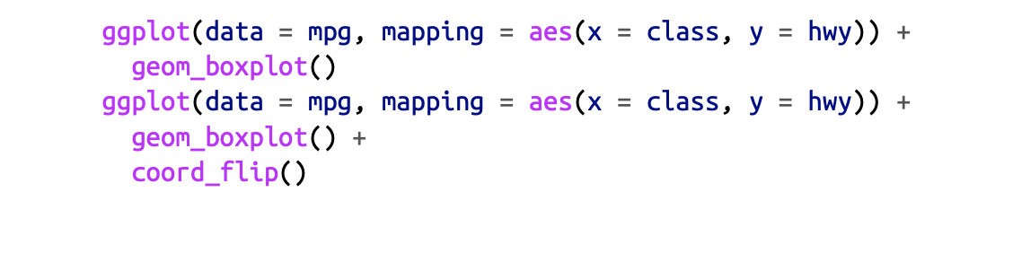
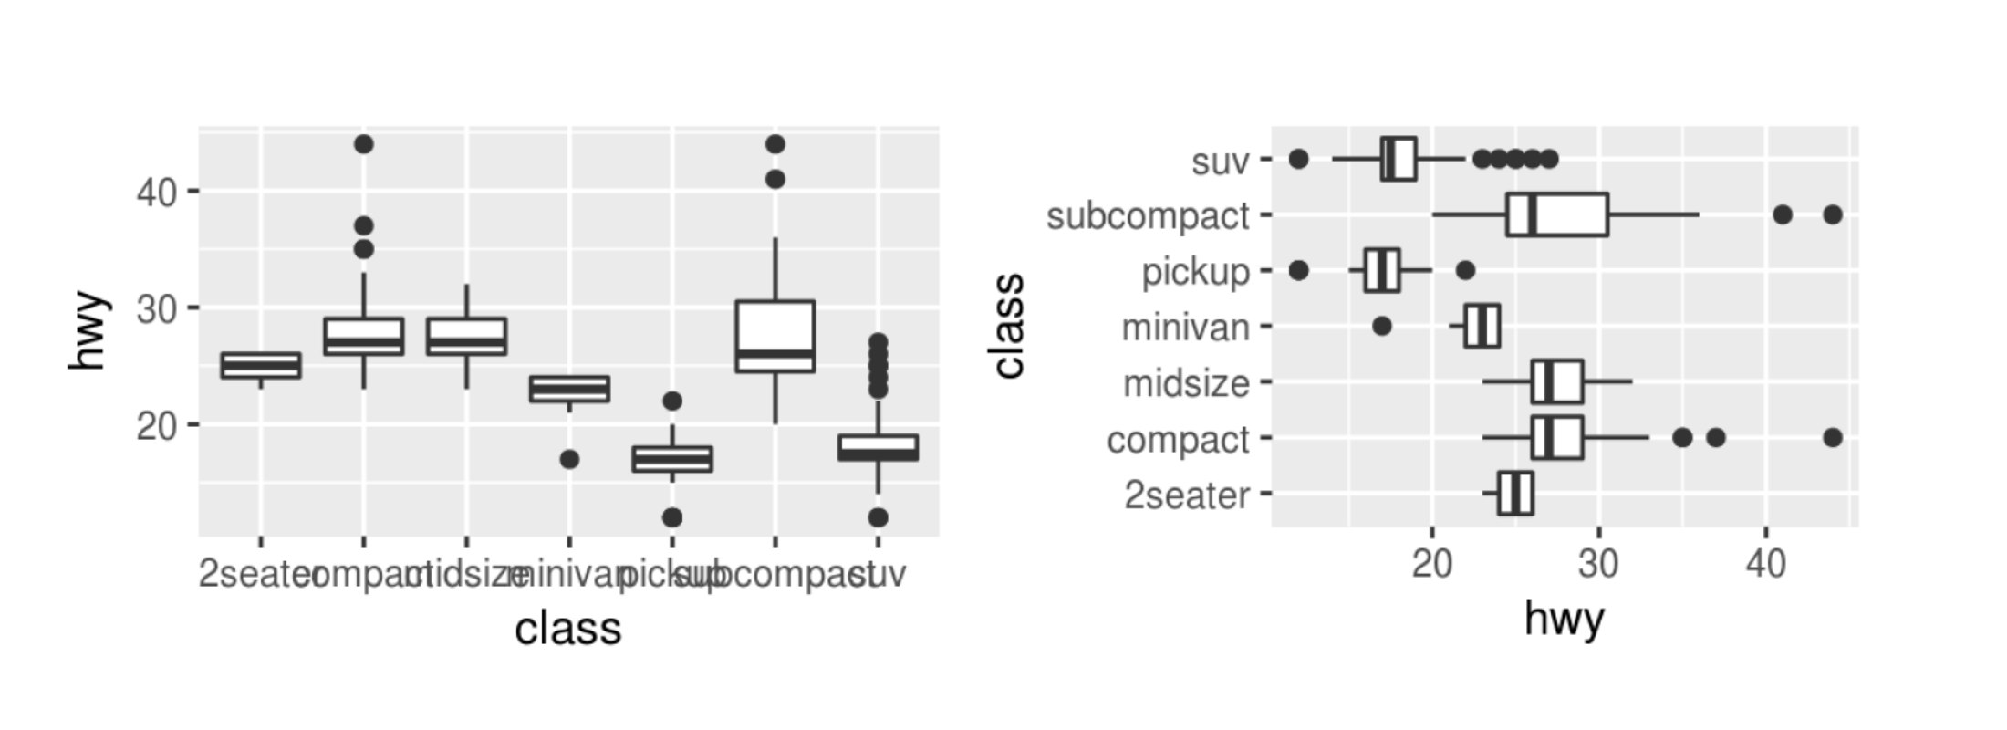
coord_flip is useful when labels overlap, for example when we have long labels or many bars in the bar chart with labels overlapping each others.

Slide 18
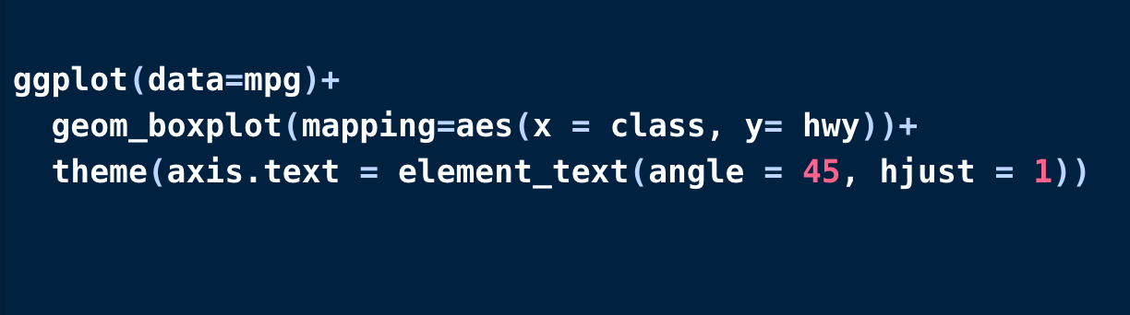
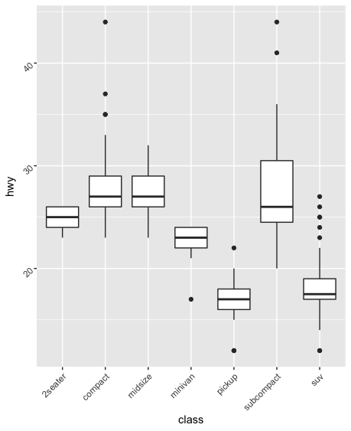
Another way to deal with overlapping labels is to change their angle.

Slide 19
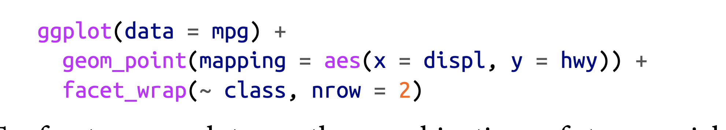
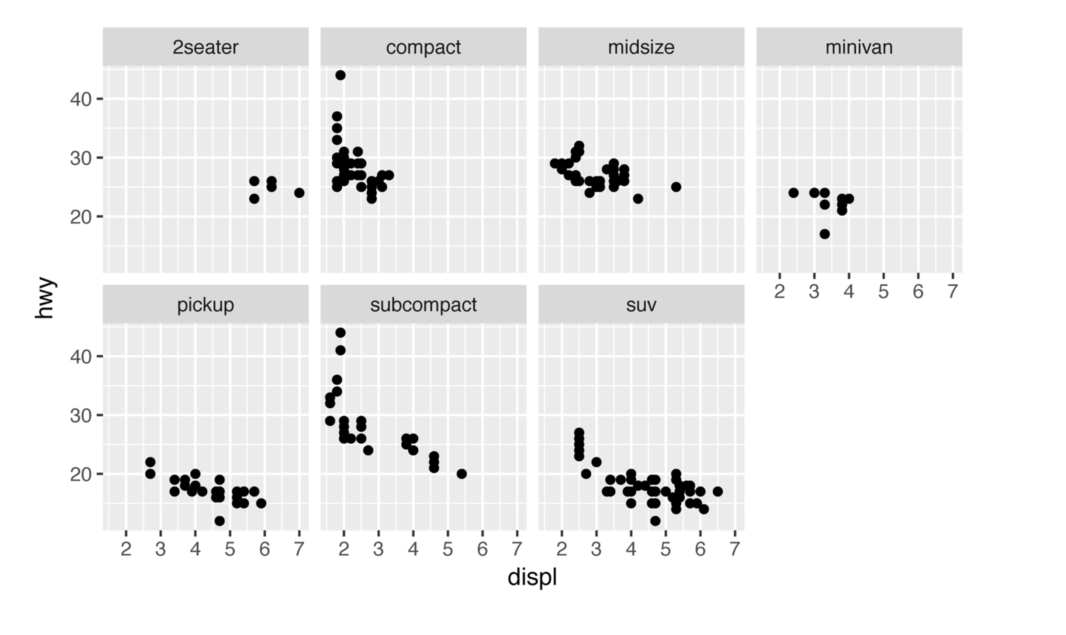
Facets
Facets are ways of grouping a visualization into multiple different pieces(subplots).
Allow us to view a separate plot for each unique value in a categorical variable.
To facet a plot by a single variable, use facet_wrap().
Notes:
One way to add additional variables is with aesthetics. Another way, particularly useful for categorical variables is to split your plot into facets, which make subplots that each display one subset of the data.

Slide 20
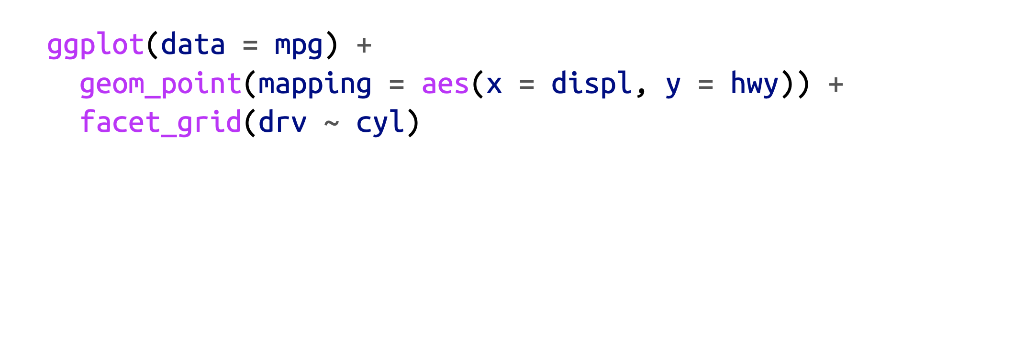
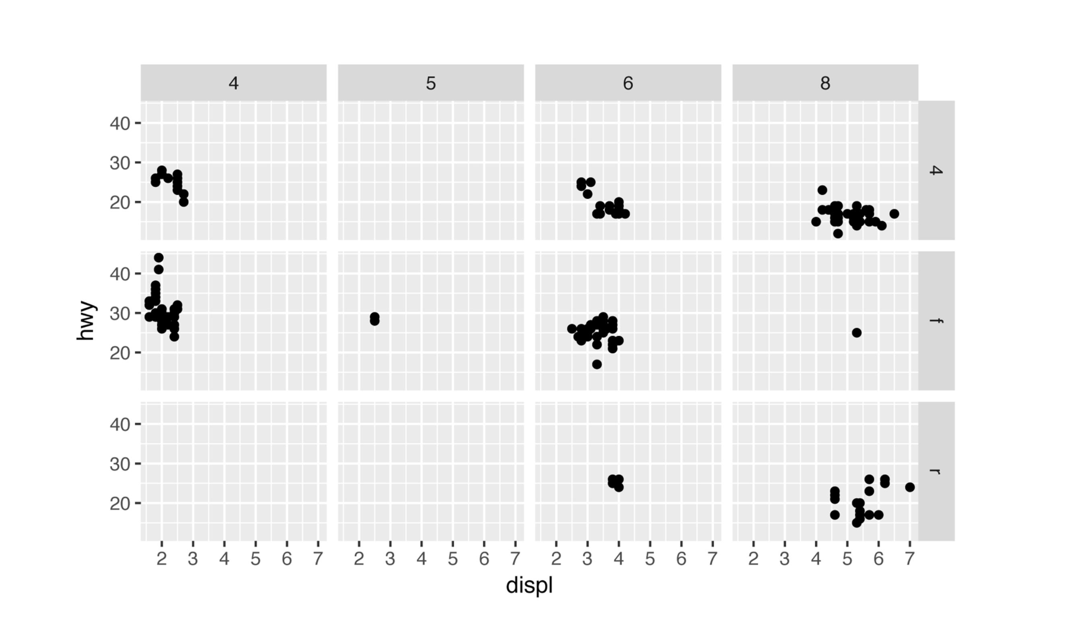
To facet a plot by a combination of two variables use facet_grid().

